Slide 1
AU Men’s Basketball Database
A centralized data system for coaching decision
Ingrid Pagan
Gage Owen
Teague Calvin
Jordan Anderson

Slide 2
The Problem
Player data is scattered across:
Spreadsheets
Handwritten Notes
Stat Websites
Coaches can’t quickly compare players, track injuries, or spot trends.

Slide 3
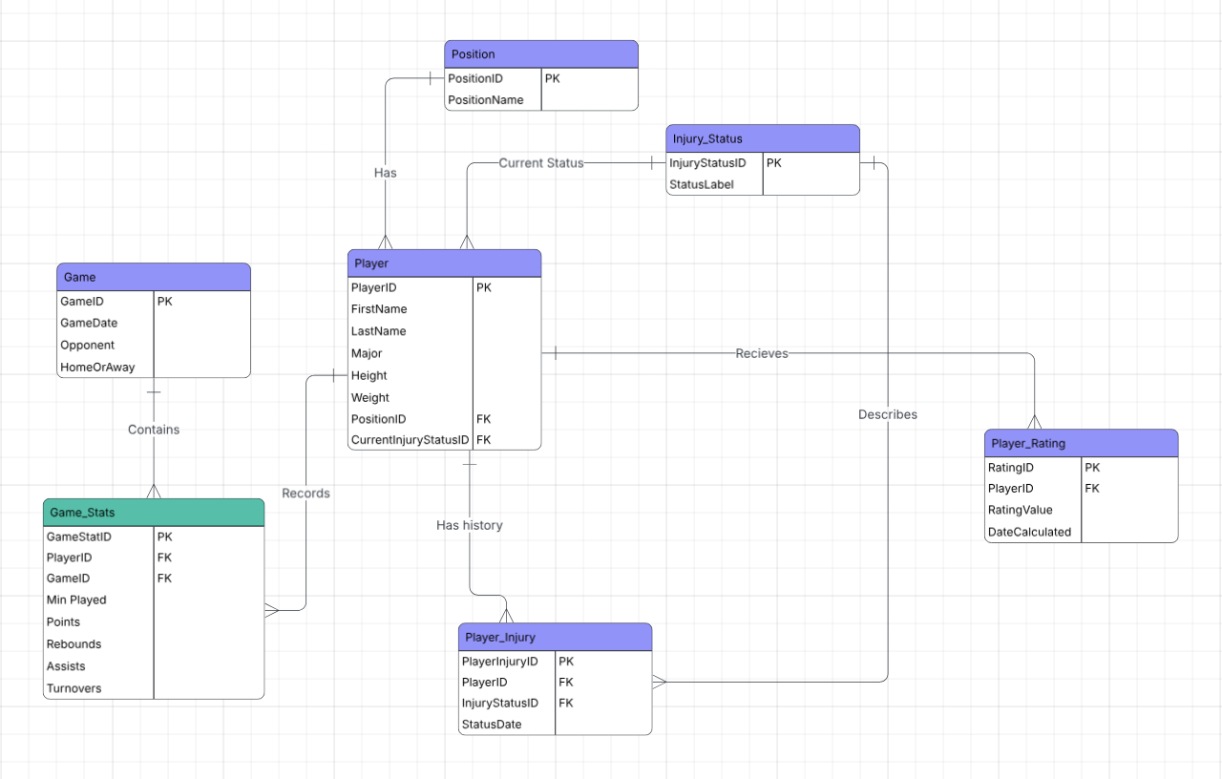
ER DIAGRAM

Slide 4
Our Solution - 8 normalized tables, fully in 3NF
PLAYER Profile, Position, Injury Status | PLAYER_RATING Efficiency ratings over time
GAME Date, Opponent, Home/Away, Season | SEASON Multi-year tracking (new)
GAME_STATS Pre-game stats - junction table | POSITION Lookup - 5 positions
PLAYER_INJURY Full injury history log | INJURY_STATUS Lookup - 4 status level

Slide 5
4 Key Design Decisions
Position and Injury Status are separate lookup tables - no transitive dependencies, consistent data entry enforced.
Resolves the many-to-many between players and games. UNIQUE(PlayerID, GameID) prevents duplicate entries.
Rating = (Pts + Reb + Ast − TO) ÷ Min. Stored with a timestamp so coaches can track development over time.
3NF Normalization
GAME_STATS as Junction Table
SEASON Table
Per-Minute Efficiency Rating
Added based on professor feedback. Every game ties to a season, this enables year-over-year analysis as data grows.

Slide 6
Data-Driven Insights
0.92
+67%
80%
Carter's efficiency rating
- highest on the team
more turnovers on the road vs. at home
6 / 10
of players had at least one injury event
players improved their rating by end of season
Notes:
Only 4 players score above team average — offense runs through Carter, Johnson, Williams & Thompson.

Slide 7
Recommendations
01
Protect Carter
02
Injury prevention program
03
Road balls security drills
04
Rating-based rotations
05
Recruit SG & PG depth
Notes:
Only starter to play all 20 games injury-free. Monitor his workload.
80% of roster had injury events. Proactive load management needed.
Turnovers jump 67% away. Add targeted practice before road trips.
Use efficiency ratings to define roles and prioritize high performers.
Anderson on IR, Davis injury-prone. Thinnest positions on the roster.

Slide 8
A tool coaches can ACTUALLY use.
Thank you!

